Slide 1




Slide 2
INTRODUCTION
BS COMPUTER SCIENCES PAF KIET
MS CYBERSECURITY NED UNIVERSITY
UJ CONSULTANT NETWORK SECURITY
METATECHWARE PROJECT MANAGER
NFT CIPHER FOUNDER
ILMA UNIVERSITY LECTURER
AREA OF INTEREST: BLOCKCHAIN, CYBER SECURITY, CLOUD COMPUTING, QUANTUM COMPUTING
https://www.linkedin.com/in/syedahsan90/

Slide 3
Welcome!!
Introduction to CEH (Cyber security)

Slide 4
Computer Security
• Keep the computer in secure place
• Create login password
• Setup BIOS password
Software and Data Security inside Computer
• Use of Antivirus and Antispyware software
• Software Firewall
• Bitlocker

Slide 5
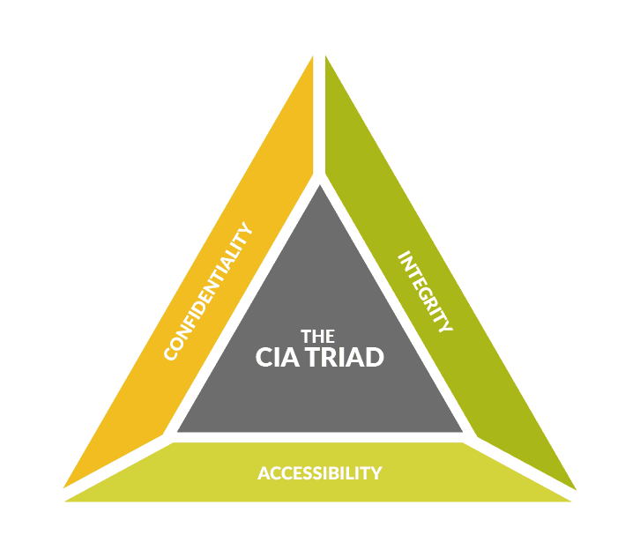

Slide 6
Key Factors in Data Security
• Confidentiality
• Integrity
• Availability
• Authenticity
• Non-Repudiation
Access Control

Slide 7
Confidentiality (Encryption)
• Protecting information from disclosure to unauthorized parties
• This type of access includes:
Printing
Displaying
Other forms of disclosure, including simply revealing the existing of an object
•Information like Bank account statements, credit card numbers, personal information should be kept in secret
•Key component of protecting information is Encryption

Slide 8
Integrity
• Protecting information from being modified by unauthorized parties
• Modification includes:
Writing
Changing
Changing status
Deleting and
Creating
• In online money transfer, if the information is tampered e.g. if the amount you sent is changed from $100 to $1000 then it could prove to be very costly
• Key component of protecting data is Hashing

Slide 9
Availability
• Ensure that the authorized parties are able to access the data all the time
• Denying access to information has become a very common attack nowadays. This is referred as DDoS attack
• Other factors may include incidents like power outage and natural disasters etc
• To ensure data availability, backups should be taken regularly, Disaster
Recovery (DR) procedures should be implemented

Slide 10
Authenticity
Authenticity is assurance that a message, transaction, or other exchange of information is from the source it claims to be from.
Key component for proving authenticity is digital signature

Slide 11
Non-repudiation
• Communication or any action that cannot be denied by the originator
• Sharing of Door Key cards and passwords should be strictly restricted

Slide 12
Access Control
Unauthorized users are kept out of the system
Access to authorized users can also be controlled using security policies

Slide 13
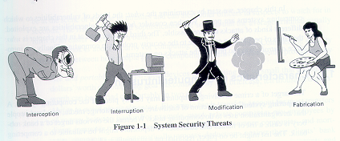
Type of Attacks/Threats in Computer Systems
A threat is a danger which could affect the security (confidentiality, integrity, availability) of assets, leading to a potential loss or damage.
Interruption
Interception
Modification
Fabrication

Slide 14
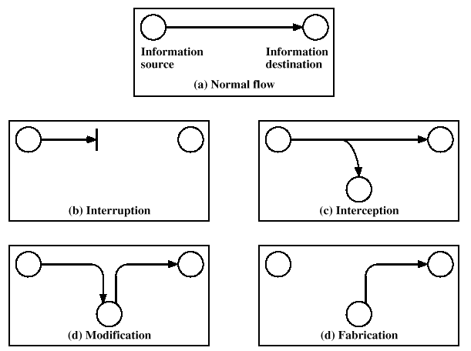
Type of Attacks in Computer Systems

Slide 15
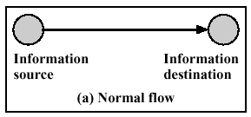
Normal Flow of Information

Slide 16
Interruption
An asset of the system is destroyed or becomes unavailable or unusable. This is an attack on the availability.
Examples include destruction of a piece of hardware, such as a hard disk, the cutting of a communication link, or the disabling of the file management system.
DOS - Denial of Service Attacks have become very well known. [DDOS]

Slide 17
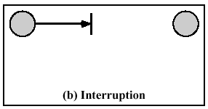
Interruption

Slide 18
Interception
Information disclosure/information leakage
An unauthorized party gains access to an asset.
This is an attack on confidentiality.
The unauthorized party could be a person, a program, or a computer.
Examples include:
  wiretapping to capture data in a network
  the illicit copying of files or programs

Slide 19
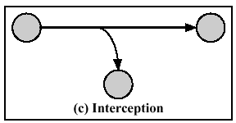
Interception

Slide 20
Modification
Modification is integrity violation.
An unauthorized party not only gains access to but tampers with an asset.
This is an attack on the integrity.
Examples include changing values in a data file, altering a program so that it performs differently, and modifying the content of a message being transmitted in a network.

Slide 21
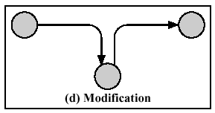
Modification

Slide 22
Fabrication
An unauthorized party inserts counterfeit objects into the system. This is an attack on the authenticity, (as well as integrity).
Inserting messages into the network using the identity of another individual
Spoofing a web site or other network service

Slide 23
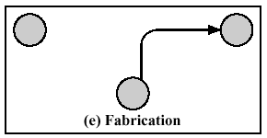
Fabrication

Slide 24
Classification of Attacks
Computer Security attacks can be classified into two broad categories:
  Passive Attacks can only observe communications or data.
  Active Attacks can actively modify communications or data. Often difficult to perform, but very powerful. Examples include
    Mail forgery/modification
    TCP/IP /session hijacking

Slide 25
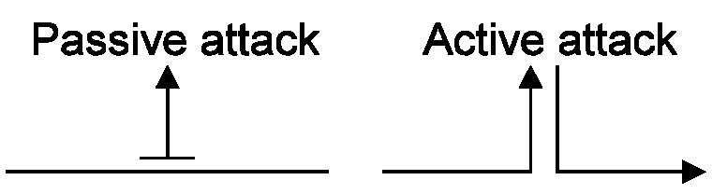
Passive Attacks and Active Attacks

Slide 26
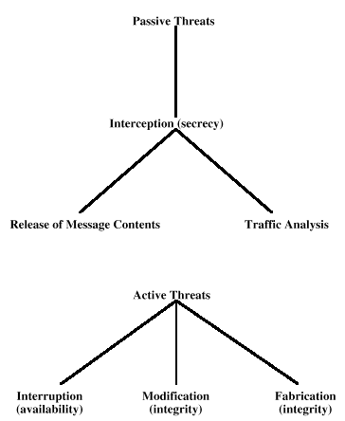
Passive Attacks and Active Attacks

Slide 27
Passive Attacks
Eavesdropping on or monitoring of transmission.
The goal of the opponent is to obtain information that is being transmitted.
Two types:
  Release-of-message contents
  Traffic Analysis

Slide 28
Release-of-message Contents
Opponent finds out the contents or the actual messages being transmitted.
How to protect?
  Encryption

Slide 29
Traffic Analysis
More subtle than release-of-message contents.
Messages may be kept secret by masking or encryption but …
The opponent figures out information being carried by the messages based on the frequency and timings of the message.
How to protect?
  Data/Message Padding
  Filler Sequences

Slide 30
Passive Attacks Problems
Difficult to detect because there is no modification of data.
Protection approach should be based on prevention rather than detection.

Slide 31
Active Attacks
Active attacks involve some sort of modification of the data stream or the creation of a false stream.
Four sub-categories:
  Masquerade
  Replay
  Modification of Messages
  Denial of service

Slide 32
Masquerade
An entity pretends to be another.
For the purpose of doing some other form of attack.
How to protect?
  Principal/Entity Authentication

Slide 33
Replay
First passive capture of data and then its retransmission to produce an unauthorized effect.
Could be disastrous in case of critical messages such as authentication sequences, even if the password were encrypted.
How to protect?
  Time stamps
  Sequence Numbers

Slide 34
Modification of Messages
Some portion of a legitimate message is altered or messages are delayed or reordered to produce an unauthorized effect.
How to protect?
  Message Authentication Codes
  Chaining (purified)

Slide 35
Thank You

